Slide 1
Advanced Extensible Interface(AXI)
By
Bommineni Nikhitha

Slide 2
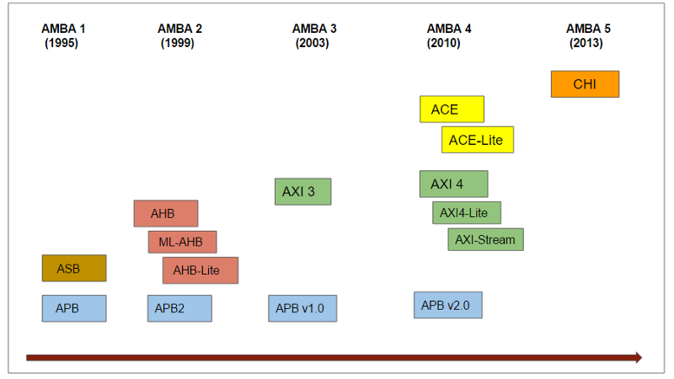
Evolution of AMBA

Slide 3
Introduction
The AMBA AXI protocol supports high-performance, high-frequency
system designs.
The AXI protocol:
• is suitable for high-bandwidth and low-latency designs
• provides high-frequency operation without using complex bridges
• meets the interface requirements of a wide range of components
• is suitable for memory controllers with high initial access latency
• provides flexibility in the implementation of interconnect
architectures.
is backward-compatible with existing AHB and APB interfaces

Slide 4
Features
the key features of the AXI protocol are:
separate address/control and data phases
support for unaligned data transfers, using byte strobes
uses burst-based transactions with only the start address issued
separate read and write data channels, that can provide low-cost Direct Memory Access (DMA)
support for issuing multiple outstanding addresses
support for out-of-order transaction completion
permits easy addition of register stages to provide timing closure.

Slide 5
Channel Architecture
The AXI protocol is burst-based and defines the following independent transaction channels:
• read address
• read data
• write address
• write data
• write response.
An address channel carries control information that describes the nature of the data to be transferred. The data is
transferred between master and slave using either:
• A write data channel to transfer data from the master to the slave. In a write transaction, the slave uses the
write response channel to signal the completion of the transfer to the master.
• A read data channel to transfer data from the slave to the master.

Slide 6
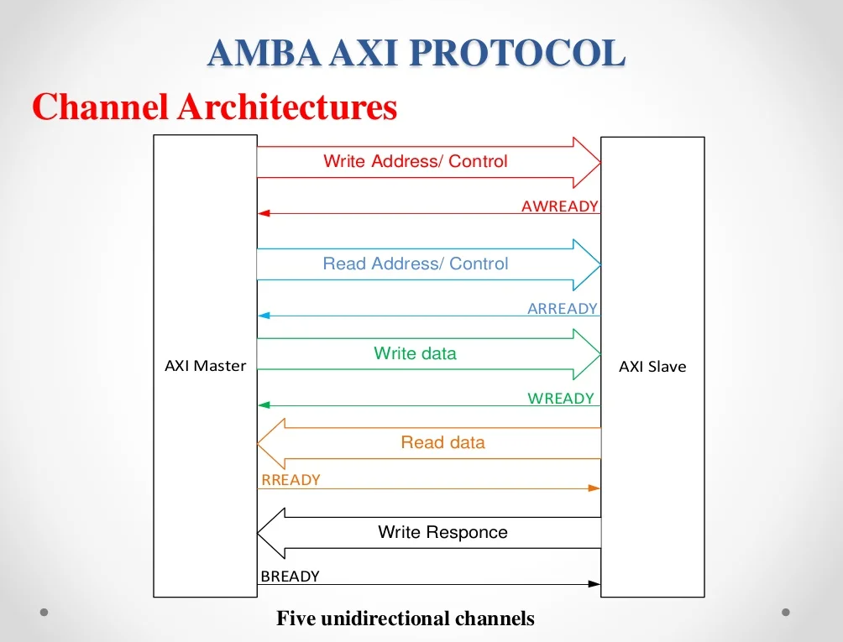

Slide 7
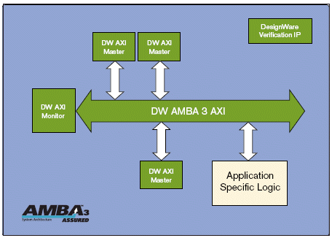
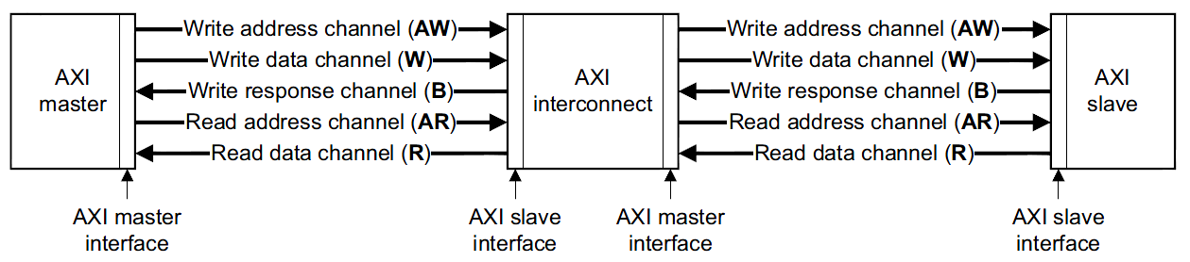
Interface,interconnect and Channel

Slide 8
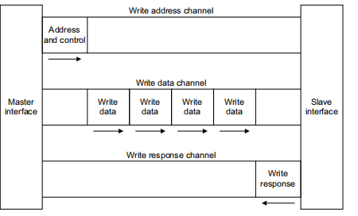
Write channel
A write data channel to transfer data from the master to the slave. In a write transaction, the slave uses the write esponse channel to signal the completion of the transfer to the master.

Slide 9
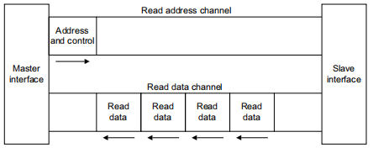
Read channel
A read data channel to transfer data from the slave to the master.

Slide 10
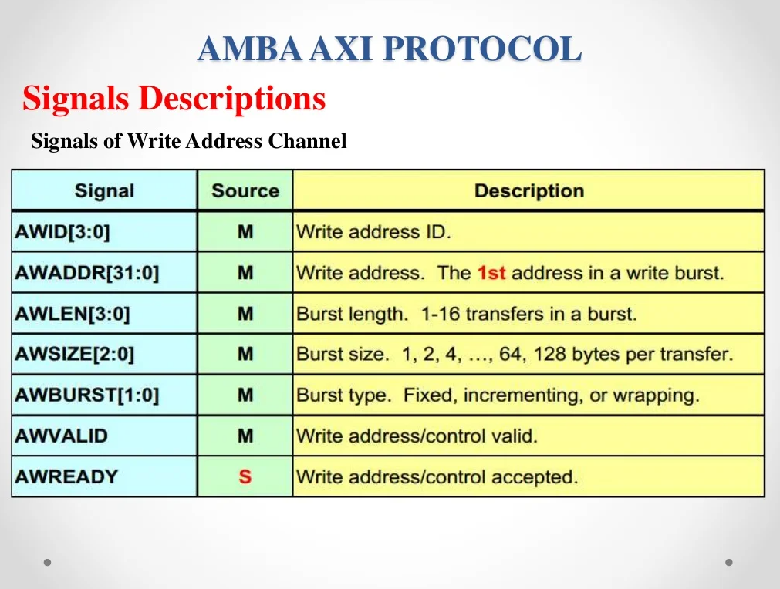

Slide 11
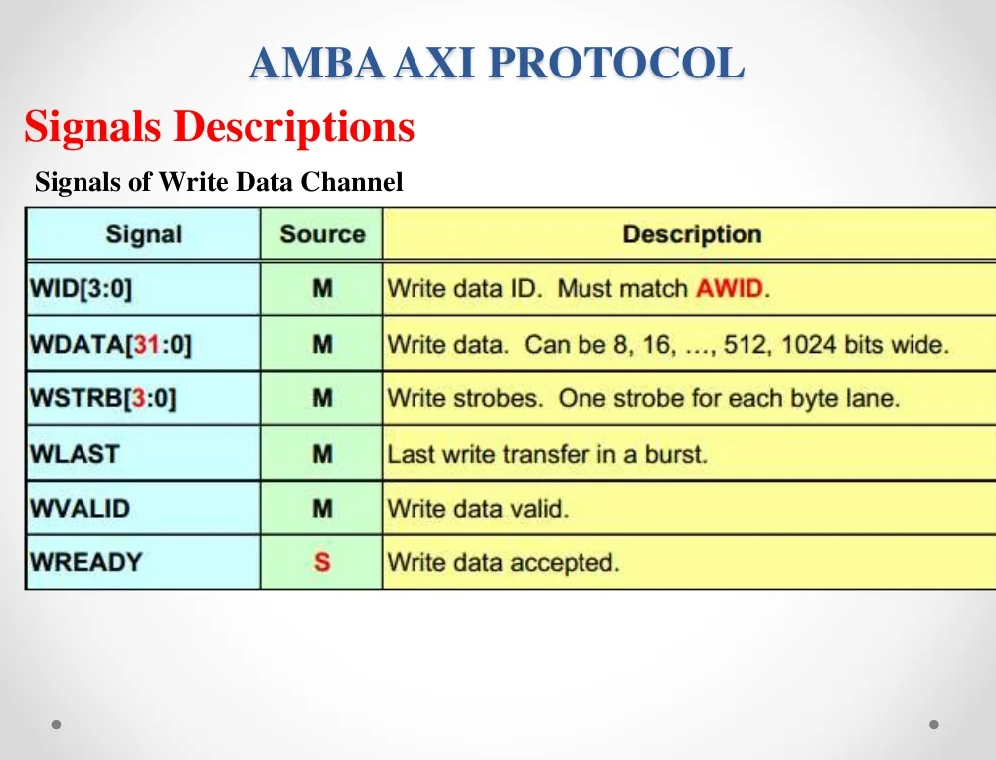

Slide 12
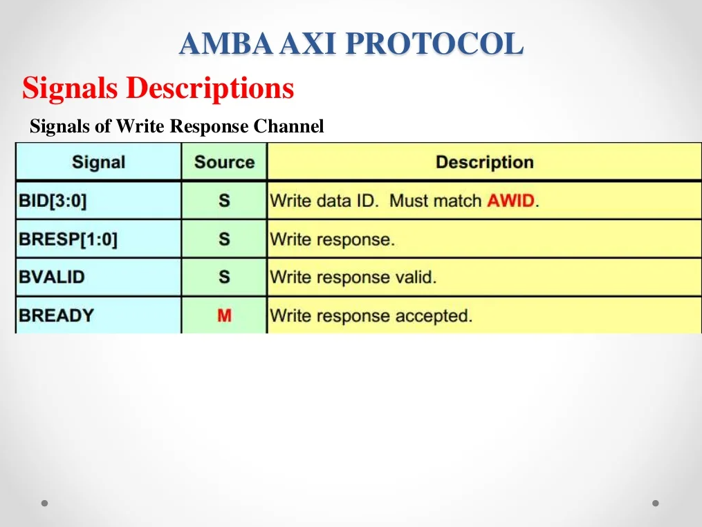

Slide 13
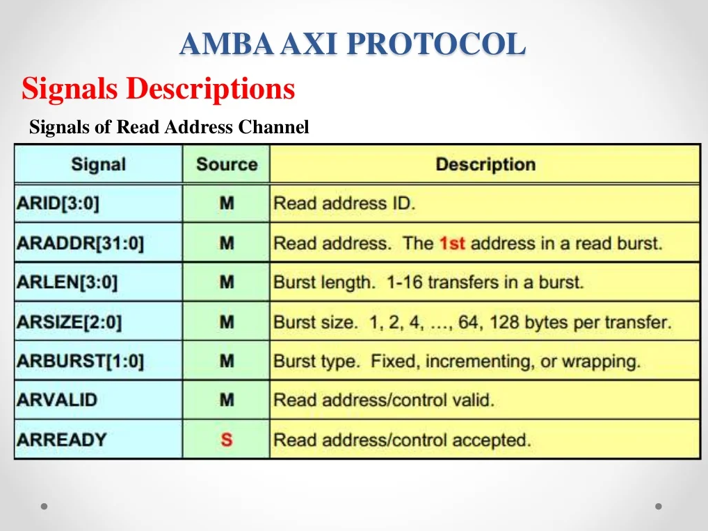

Slide 14
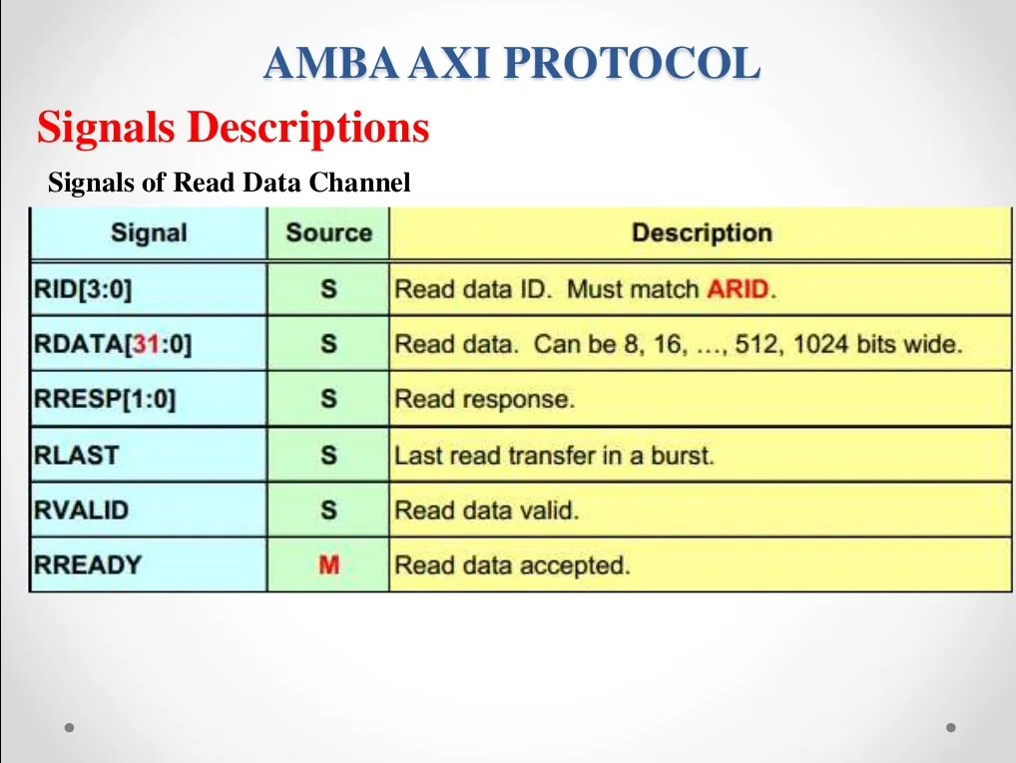

Slide 15
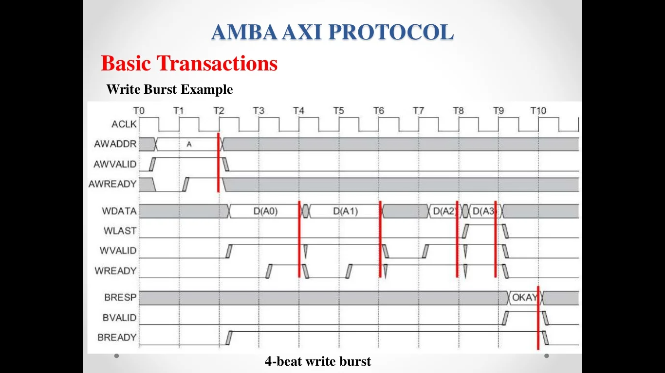
Write Burst Transaction

Slide 16
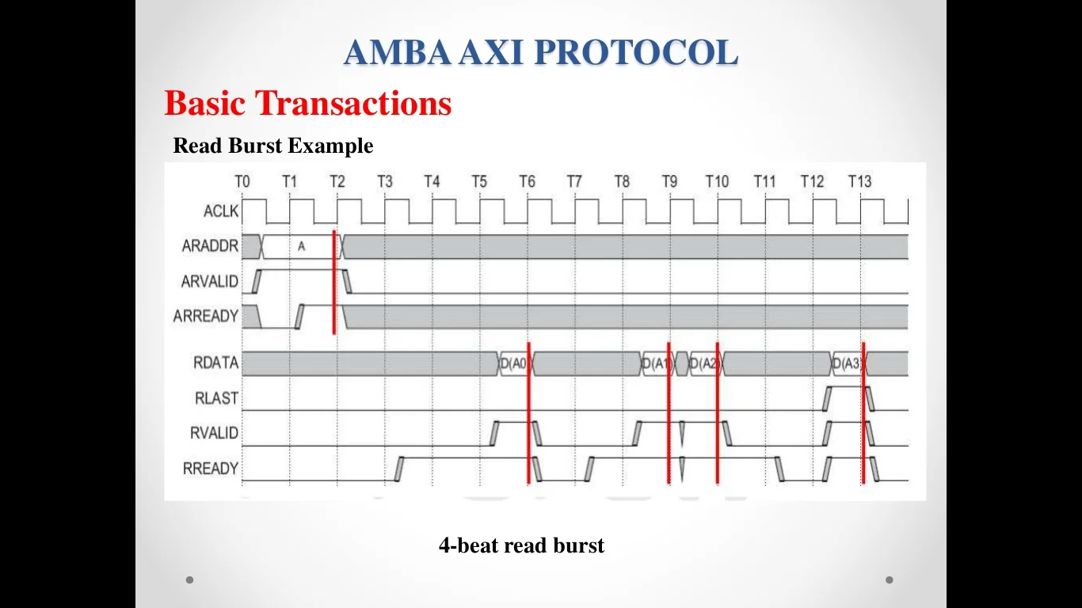
Read Burst Transaction

Slide 17
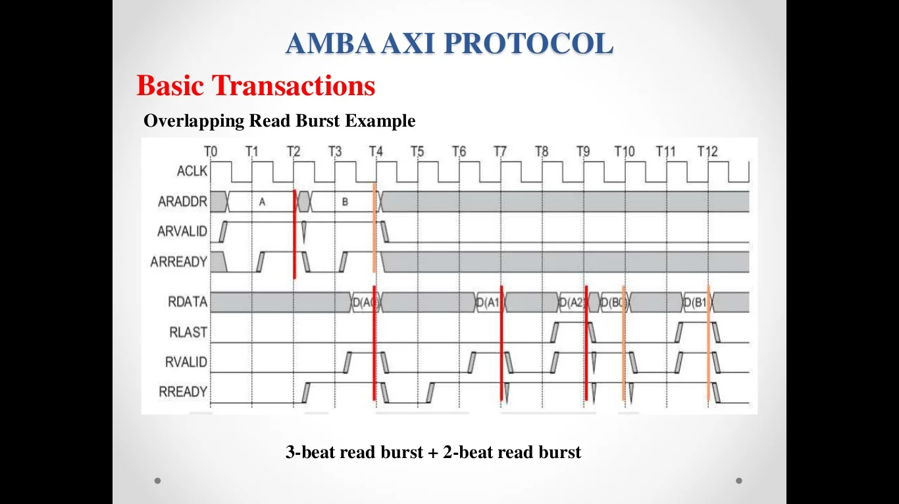
Overlapping Read Burst

Slide 18
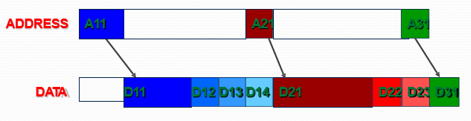
AXI Burst- Start Address of the Burst
Separation of address and data channel
Master provides the start address of burst
Slave needs to generate the remaining addresses based on burst type (FIXED, INCR, WRAP)
Reduces the address channel utilization.

Slide 19
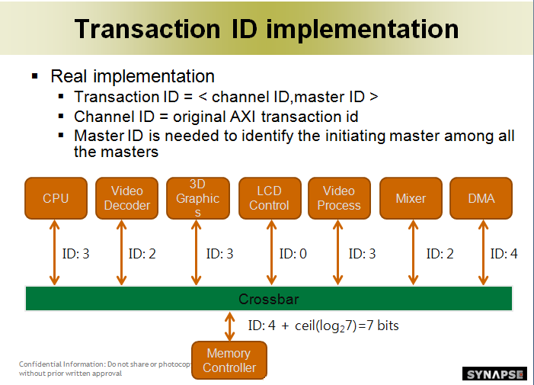
Transaction ID Implementation

Slide 20
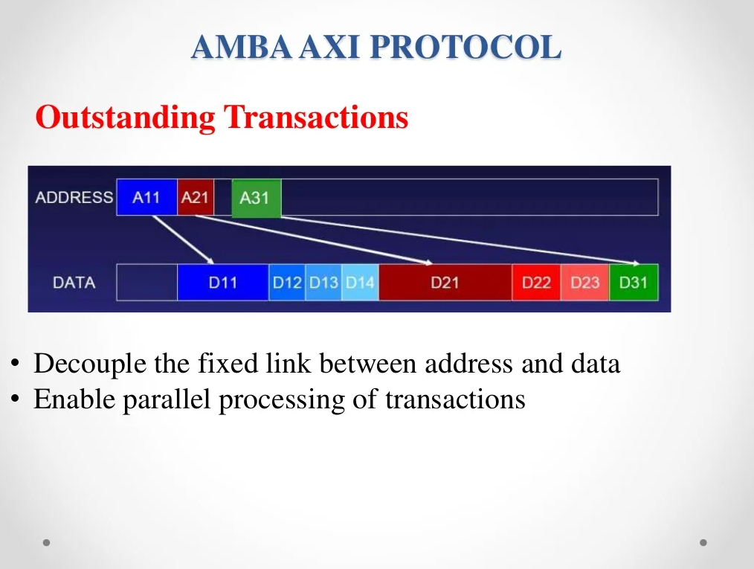
Multiple Outstanding Address
Decouple the fixed links between address and data
Enable parallel processing of transactions.
Outstanding Transactions are the transactions /request for which response has not received yet.

Slide 21
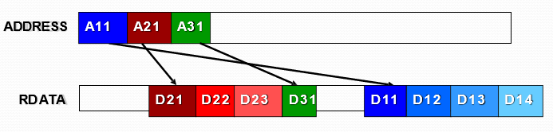
Out-of-order Address
Ordering by transaction ID
Slave can handle data transfers with different transaction IDs out-of-order.
The order within a single burst is maintained.
Fast-responding slaves may return before the slow slave and complex slave may return data out-of-order.
Effectively reduces the transaction delay.
Out-of-order completion:
In AXI, a transfer is not completed until the bus master receive the response from the read data channel or write response channel. Also after a bus master issue a transfer, it can issue another transfer without waiting for the first one to complete. If the order of the responses coming back from the slaves arrived in different order from the order that the transfers were issued, we can call it out of order completion.
Out of order data is controlled by ID of the transaction (AWID or ARID). Transactions carrying the same ID should come in the order they are generated, different IDs can come out of order.

Slide 22
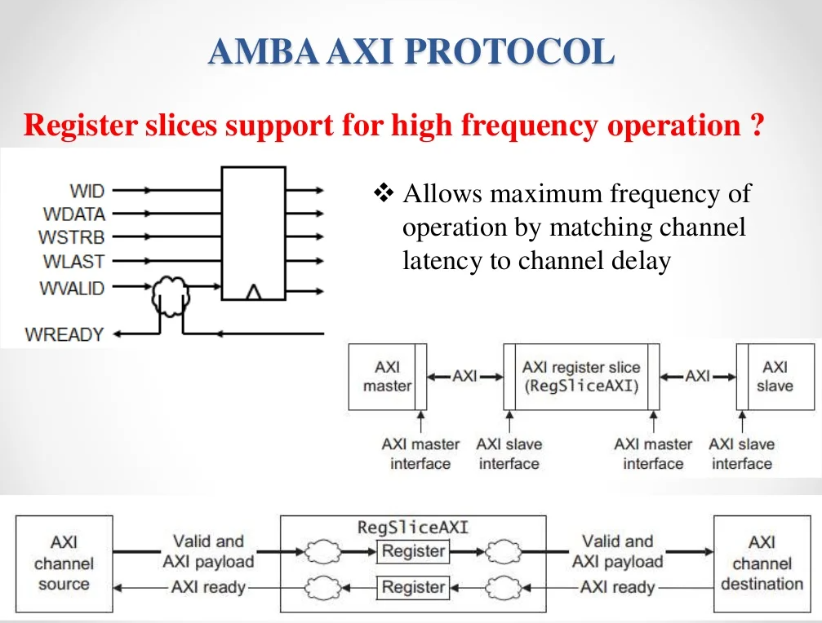
Register Slices

Slide 23
Register slices
Each AXI channel transfers information in only one direction, and the architecture does not require any fixed relationship between the channels. This means a register slice can be inserted at almost any point in any channel, at the cost of an additional cycle of latency.
This makes possible:
- A trade-off between cycles of latency and maximum frequency of operation a direct, fast connection between a processor and high performance memory, but to use simple register slices to isolate a longer path to less performance critical peripherals.

Slide 24
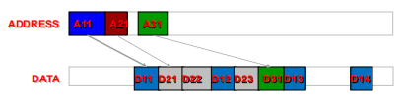
Write Interleaving
Interleaving rule
– Data with different ID can be interleaved.
– The order within a single burst is maintained
– The order of first data needs to be the same with that of request
– Write Interleave Cability →
The maximum number of transactions that master can interleave.

Slide 25
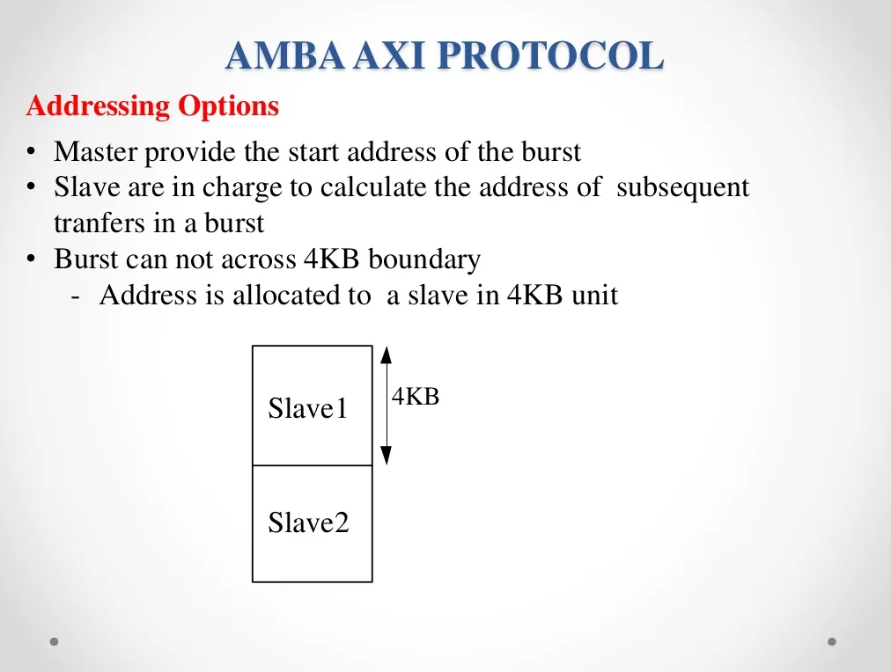
Addressing options

Slide 26
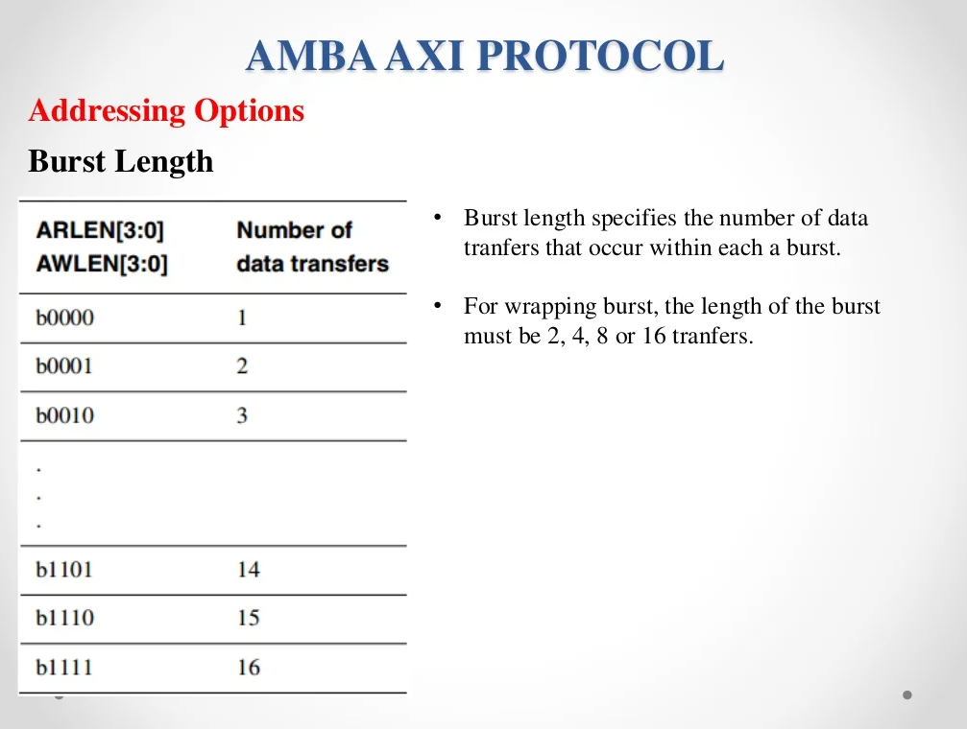

Slide 27
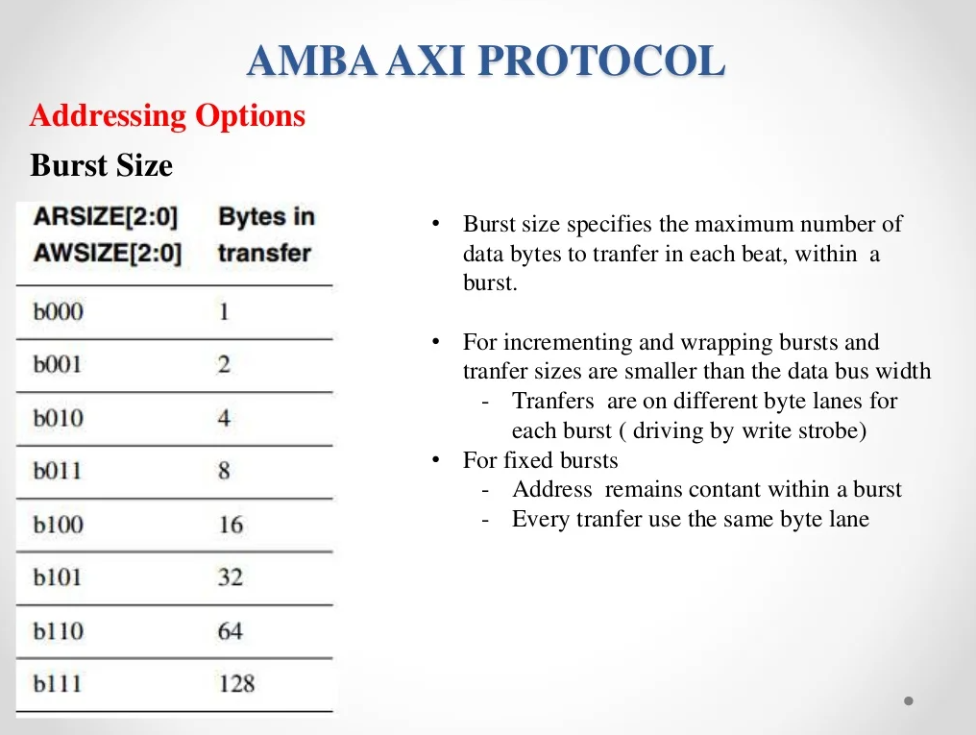

Slide 28
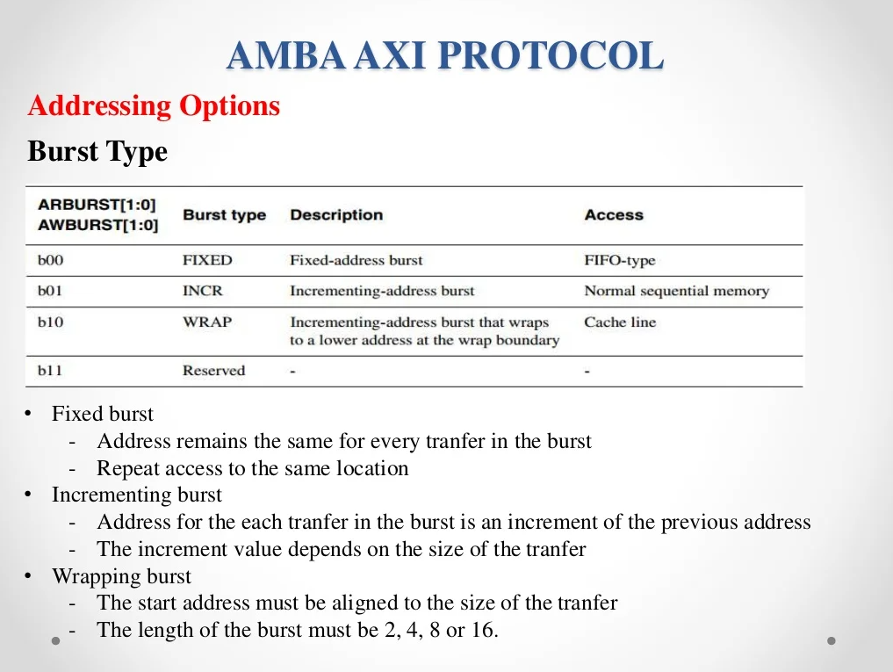

Slide 29
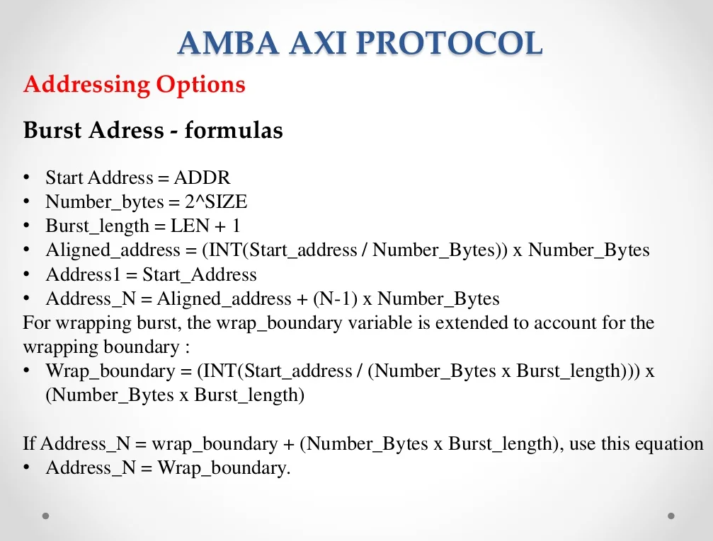

Slide 30
Wrap Calculation
AxADDR = 0x04, AxLEN = 3, AxSIZE = 2, AxBURST = 3
Start_Address = 0x04, Burst_Length = 4, Number_Bytes = 4
Wrap_Boundary = (INT(Start_Address/(Number_Bytes×Burst_Length)))×(Number_Bytes×Burst_Length)
= (0x04/(4×4)) x (4×4) = 0
Address_N = Wrap_Boundary + (Number_Bytes × Burst_Length)
= 0 + (4 x 4) = 16
As Burst_Length is 4, Burst consists of 4 Address,
Condition, If the Address_n == 16, Address_n = wrap_boundary = 0
- Address_0 = 4
- Address_1 = Address_0 + Number_Bytes = 4 + 4 = 8
- Address_2 = Address_1 + Number_Bytes = 8 + 4 = 12
- Address_3 = Address_2 + Number_Bytes = 12 + 4 = 16
- As per condition, Address_3 == 16, so Address_3 = 0
Therefore, ADDRESSES are 4, 8, 12, 0

Slide 31
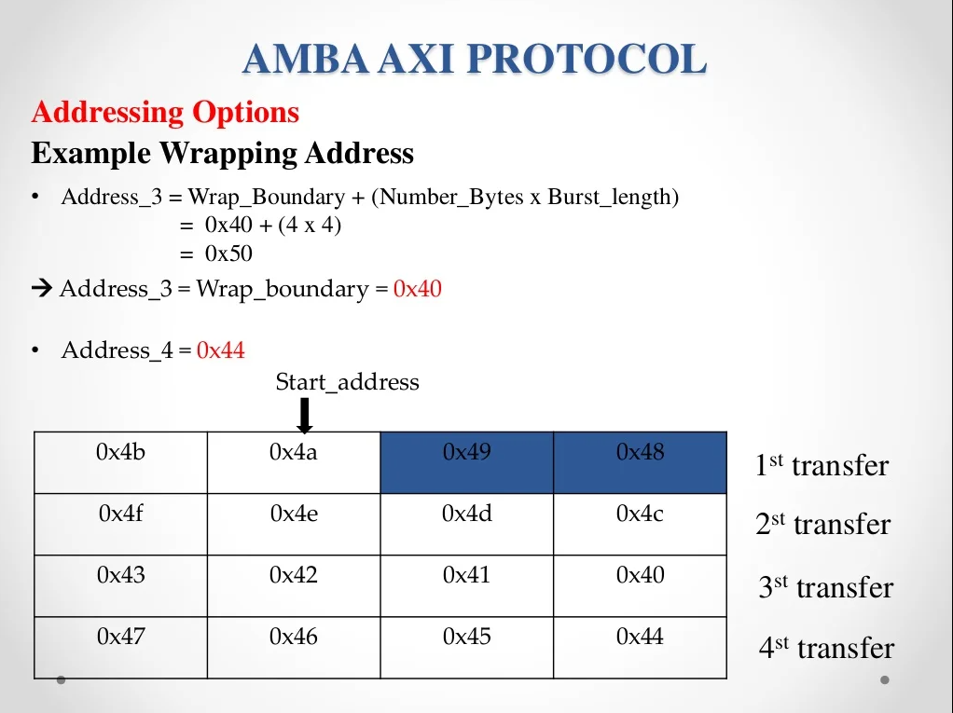

Slide 32
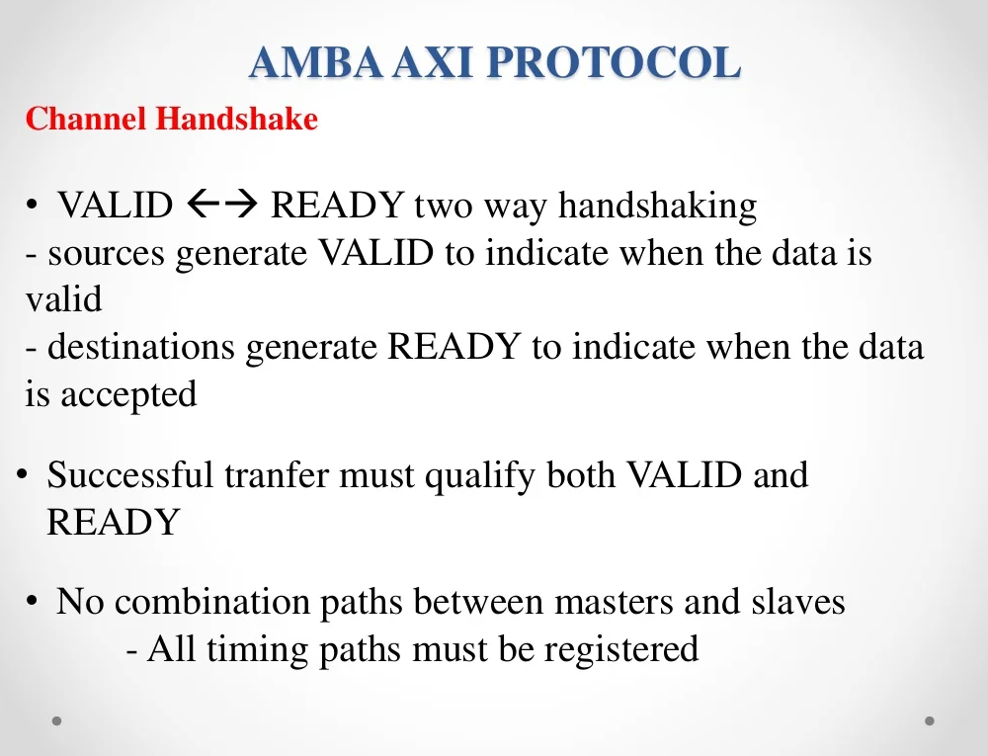
Hand Shaking Process

Slide 33
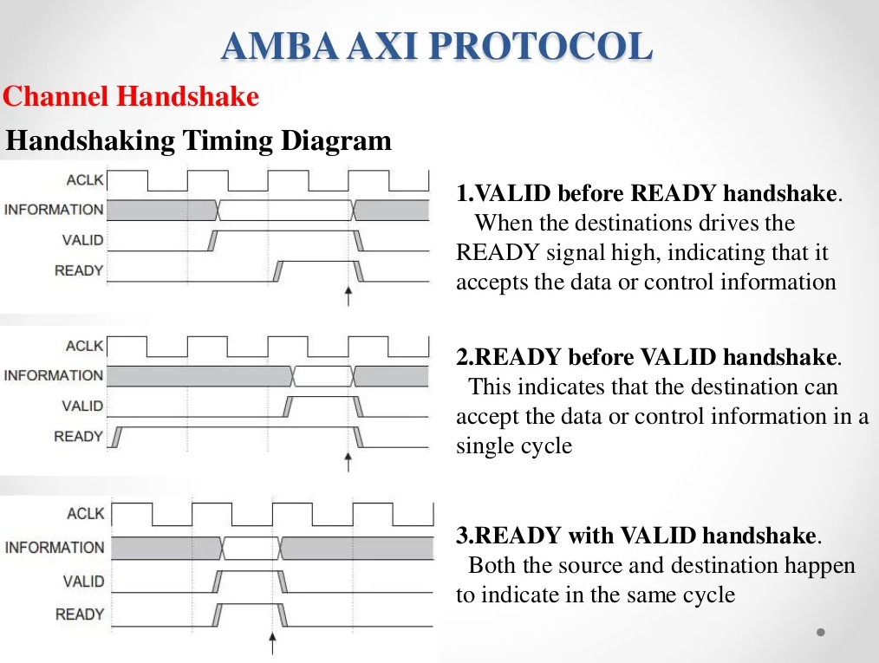

Slide 34
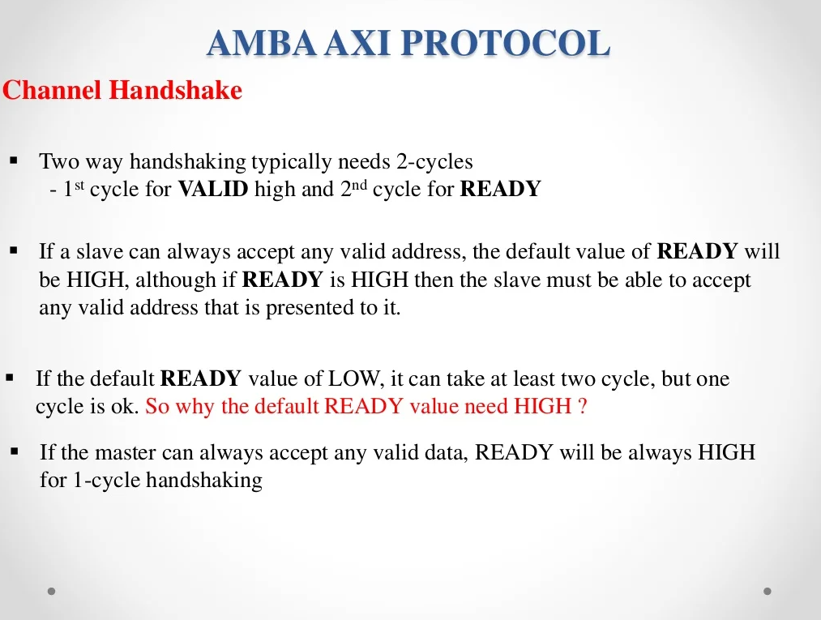

Slide 35
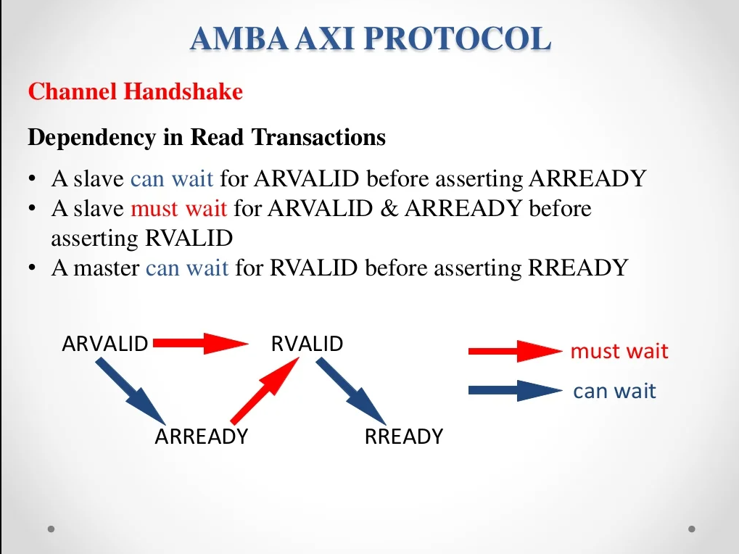

Slide 36
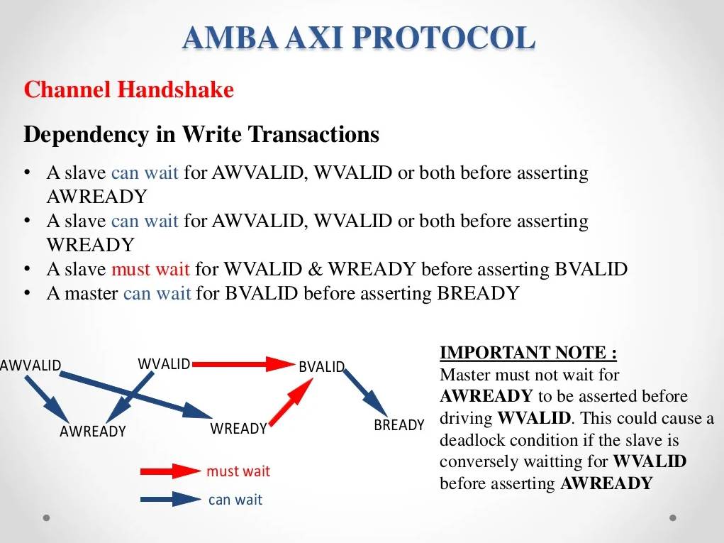

Slide 37
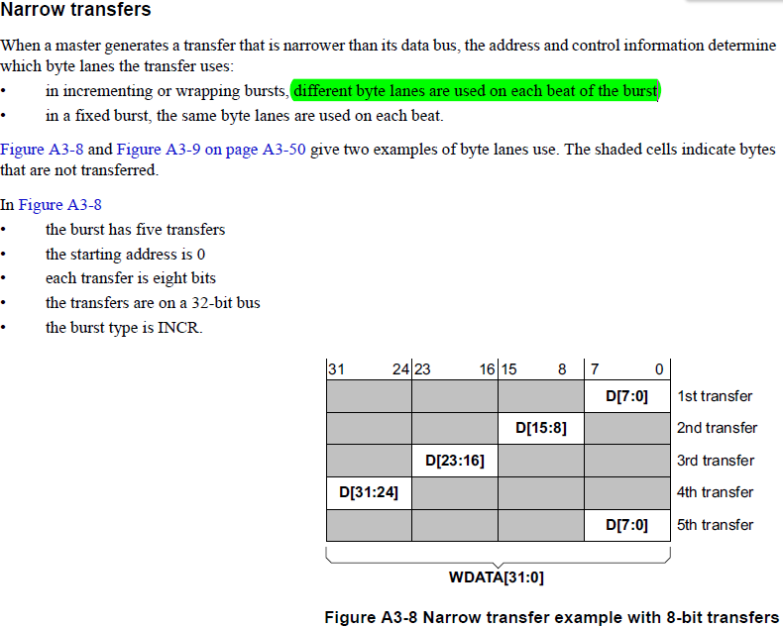
Narrow Transfers

Slide 38
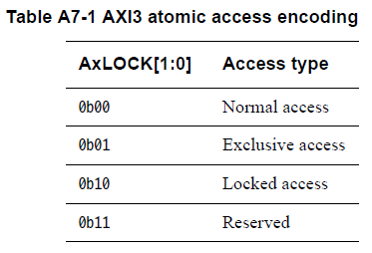
Atomic Acessing
Normal access -- AR(W)LOCK[1:0]=b00
Exclusive access , b01
M- first Exclusive read …
Slave will be ex-okay rsp.
then M - Exclusive write.
then if no other master acess that then slave will give ex-ok rsp back.
If no intervening write to the address region, EXOKAY response. If not, OKAY response.
▪ Start with b11, and end with b00
▪ During the period, only the lock initiating master can access the address region (not the slave!!!)

Slide 39
Locked access:
Start with b11, and end with b00
During the period, only the lock initiating master can access the address region (not the slave!!!)
AXI4 does not support locked transactions. Only Normal access and Exclusive acess are supported by AXI4.
However, an AXI3 implementation must support locked transactions.
AXI4 removes support for locked transactions because:
the majority of components do not require locked transactions
the implementation of locked transactions has a significant effect on:
the complexity of the interconnect
the ability to make QoS guarantees.

Slide 40
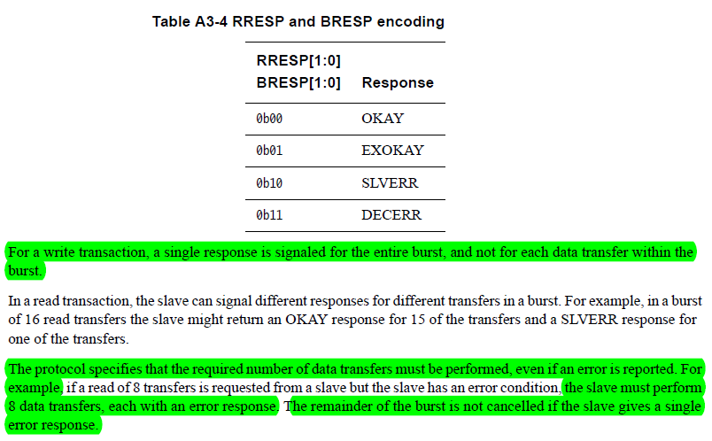
Response Signals
1.OKAY
Normal access success/Exclusive access failure/Exclusive access to non- supporting Slave.
2.EXOKAY
Exclusive access success.
3.SLVERR
Slave generates error response/ unsupported transfer size/WR access to RO/timeout condition in slave/access to address where no register present/access to disabled or powered-down function.
4.DECERR
Can not Decode Slave Access then interconnect or default slave gives DECERR.
(Note: For a write transaction, there is just one response given for the entire burst and not for each data transfer within the burst. In a read transaction, the slave can give different responses for different transfers within a burst.)

Slide 41
Cache Support
Support for system level caches and other performance enhancing components is provided by the use of the cache information signals, ARCACHE and AWCACHE. These signals provide additional information about how the transaction can be processed.
The ARCACHE[3:0] or AWCACHE[3:0] signal supports system-level caches by providing the bufferable, cacheable, and allocate attributes of the transaction:
Bufferable (B) bit, ARCACHE[0] and AWCACHE[0]
- When this bit is HIGH, it means that the interconnect or any component can
delay the transaction reaching its final destination for an arbitrary number of
cycles. This is usually only relevant to writes.
Cacheable (C) bit, ARCACHE[1] and AWCACHE[1]
- When this bit is HIGH, it means that the transaction at the final destination does
not have to match the characteristics of the original transaction.

Slide 42
For writes this means that a number of different writes can be merged together.
For reads this means that a location can be pre-fetched or can be fetched just once for multiple read transactions.
To determine if a transaction should be cached this bit should be used in conjunction with the Read Allocate (RA) and Write Allocate (WA) bits.
Read Allocate (RA) bit, ARCACHE[2] and AWCACHE[2]
- When the RA bit is HIGH, it means that if the transfer is a read and it misses in
the cache then it should be allocated.
- The RA bit must not be HIGH if the C bit is low.
Write Allocate (WA) bit, ARCACHE[3] and AWCACHE[3]
- When the WA bit is HIGH, it means that if the transfer is a write and it misses in
the cache then it should be allocated.
- The WA bit must not be HIGH if the C bit is low.

Slide 43
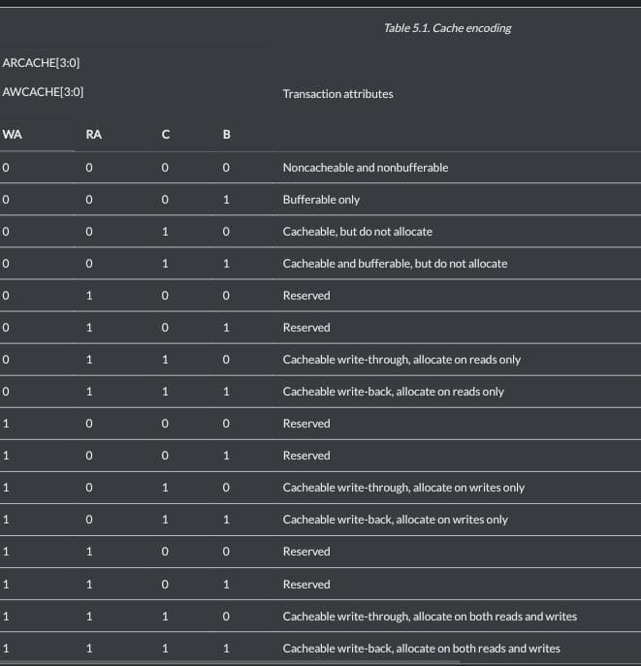

Slide 44
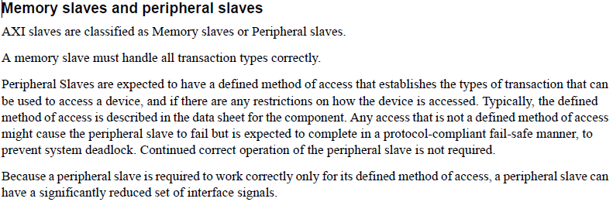
Memory slaves and Peripheral slaves

Slide 45
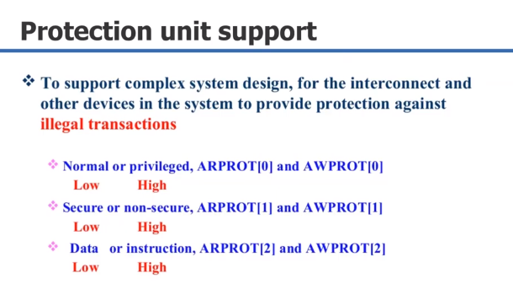

Slide 46
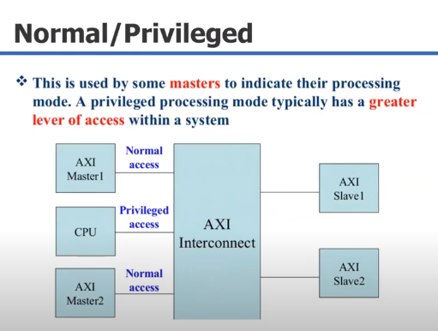

Slide 47
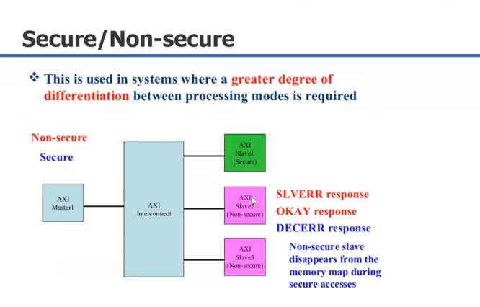

Slide 48
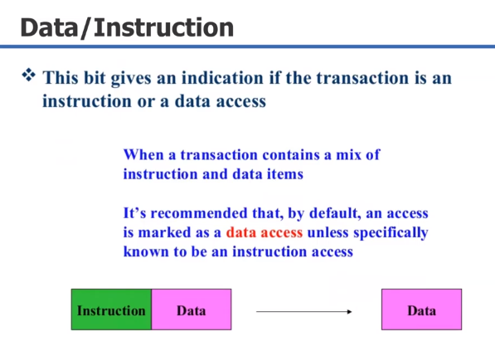

Slide 49
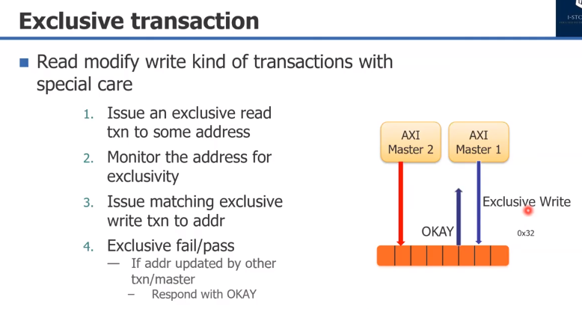

Slide 50
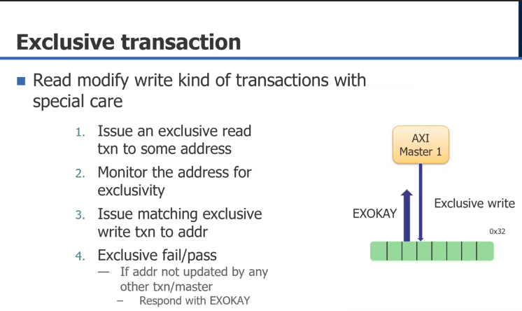

Slide 51
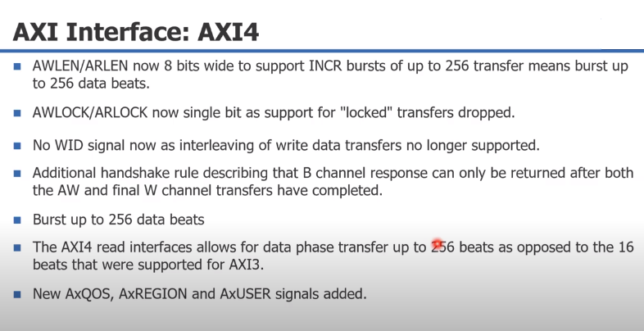

Slide 52
Support for "write data interleaving" was added in the AXI3 spec as a way of maximising data bus bandwidth
when masters couldn't generate write data in continuous bursts, with the ID allowing a slave to work out which
outstanding write data stream the received transfers related to.
However we saw this rarely used as it required more complexity in the masters and slaves involved ingenerating and decoding the interleaved transfers, and instead designers preferred to buffer up the write data at source and then send it in one continuous burst of write data transfers.
As a result, AXI4 removed support for write data interleaving, which then removed the need for the WID signal
(it was only needed to work out which outstanding write transaction the data related to). The primary reason
for removing WID was NOT to reduce the interface pin count, it was imply that the WID signal was no longer
needed.
So when looking at AXI4 write transactions, the order write data transfers will be seen is defined by the order
the write address transfers are seen, with all the data for the first received write address transfer being received
before the first data for the second received write address transfer.
"Out of order" transactions are just a particular implementation of "write data interleaving" where later started
write transactions can complete before earlier started transactions, so both are no longer supported by AXI4
interfaces.

Slide 53
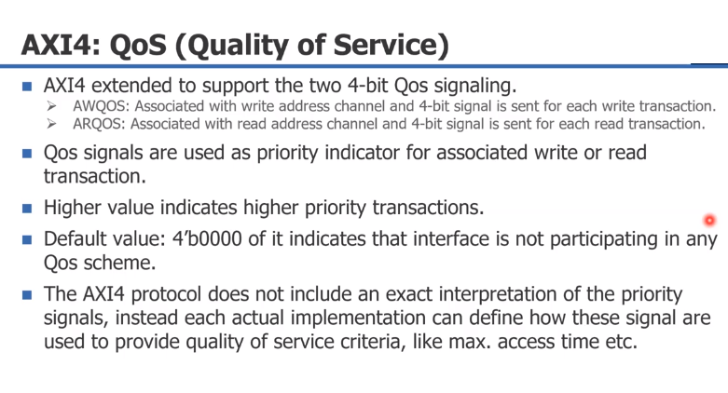

Slide 54
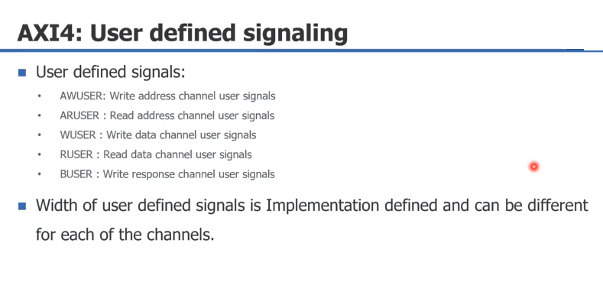

Slide 55
